Slide 1



EMEP TFMM
24rd Meeting 10-12 May 2023
THEMATIC SESSION: EMEP O3/VOC INTENSIVE MEASUREMENT PERIOD
(Preliminary results)
Biogenic tracers and other chemical species in PM during the EMEP campaign,
Jean-Luc Jaffrezo (IGE, France)
May 11th, 9h20 – 09h40

Slide 2
Objectives
Sampling and chemical characterization of atmospheric PM
7 days + 1 blank filter during the sampling campaign
Many sites
Analysis centralized at IGE for biogenic tracers (and other compounds)

Slide 3
Sites and sampling characteristics
23 sites ; mix of Rural and Urban ; 200+ samples
mix of PM10 and PM2,5; mostly daily ; mix of HiVol and LowVol

Slide 4
Sample processing and analyses
Samples kept cool / frozen during transport to IGE / France
Extraction about 10 – 15 cm2 in 7 ml Milli-Q water (orbital shaking)
Filtration on Teflon serynge with 0,22 µm
Analyses of ECOC with EUSAAR2 protocol in some cases
Trying to obtain ECOC data from partners when possible
Analyses in 1 batch of all samples with 2 methods :
  « classical » anions / cations (IC-MS)
  Large series of organic acids (IC-MS)
  Sugars and similar species (LC-MSMS)

Slide 5
Chemical species analyzed
  Chemical species tracers or indicators of many biogenic sources
    BSOA from isoprene The 4 2-Methyl-Tetrols together
    BSOA from alpha – pinene 3 - MBTCA
    BSOA from marine biogenic emissions MSA
    PBOA linked with fungal spores Arabitol / Manitol
    Probably other PBOA sources Glucose, ..
  Classical ionic species :
    nitrate, sulfate, ammonium SIA
    Na+, Cl-, Mg2+ Marine source
    K+, Ca2+ Dust
  Other tracers / indicators
    Biomass burning Levoglucosan
    Extent of oxydation of Organic matter Many organic acids

Slide 6
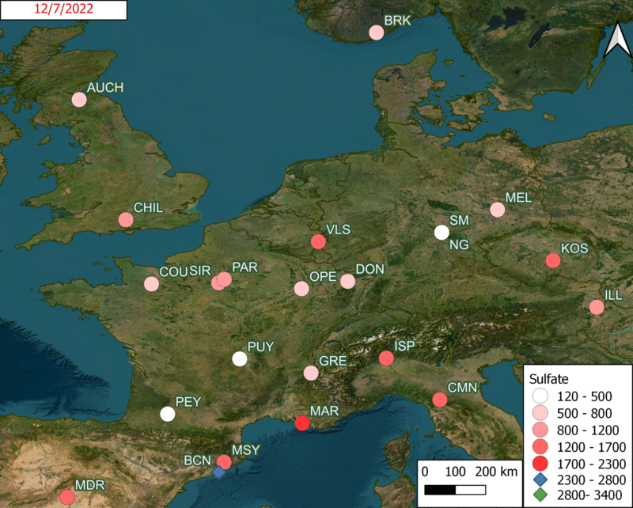
Vizualization of sulfate concentrations

Slide 7
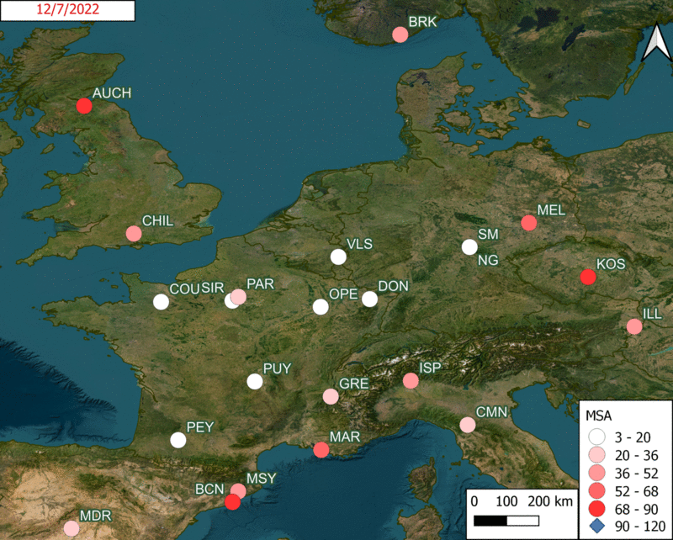
Vizualization of MSA concentrations
(marine biogenic)

Slide 8
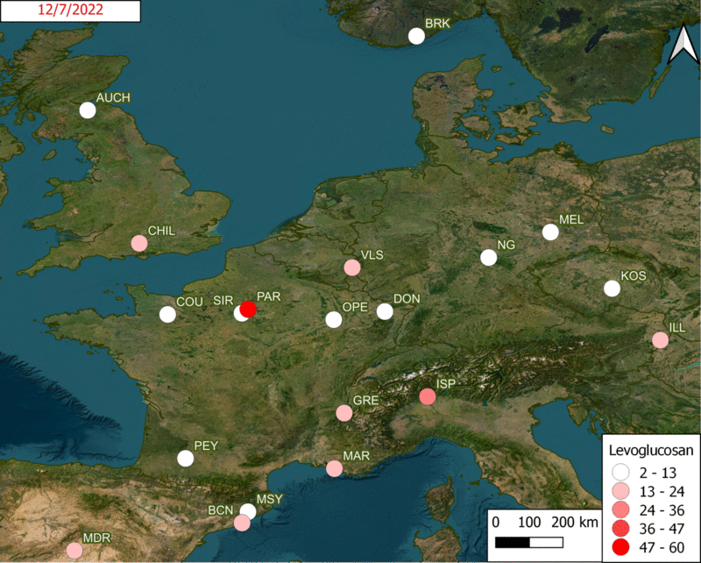
Vizualization of
levoglucosan concentrations
(Biomass burning)

Slide 9
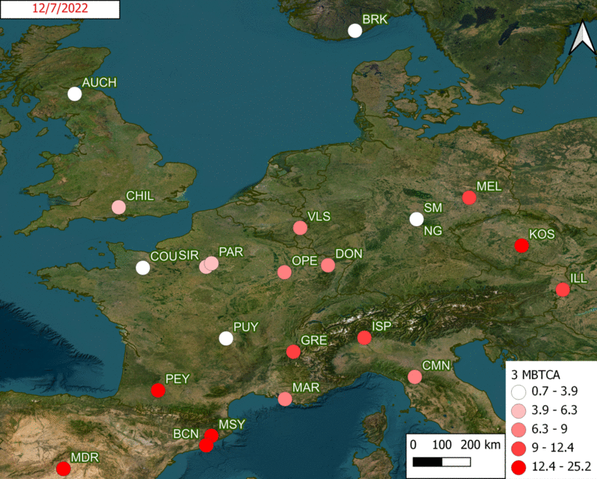
Vizualization of
3- MBTCA concentrations
(SOA alpha pinene)

Slide 10
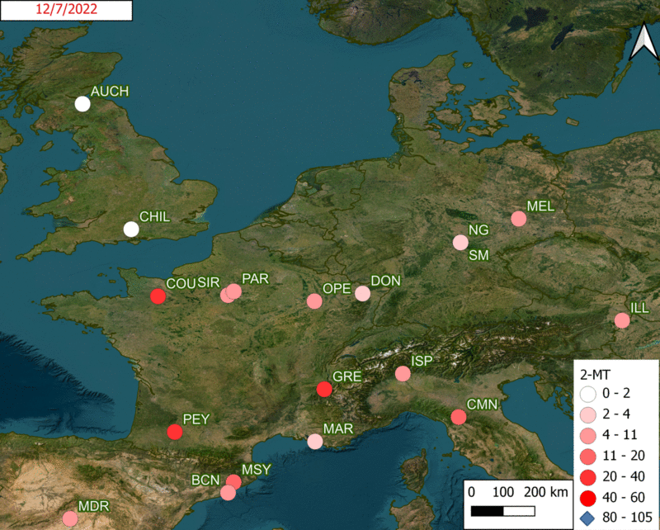
Vizualization of
2-MT concentrations
SOA isoprene

Slide 11
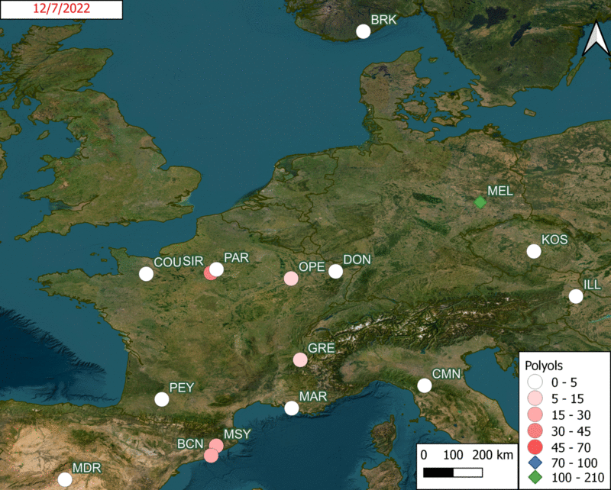
Vizualization of
polyols concentrations
PBOA fungal spore
Arabitol + mannitol

Slide 12
Making use of the data
  Completing the ECOC series
  Finalizing the transfert to EBAS
  Doing many statistics, as exemplified by Wenche
  Looking at some diagnostic ratios
  Using the data vs modeling results
  Estimating biogenic OC

Slide 13
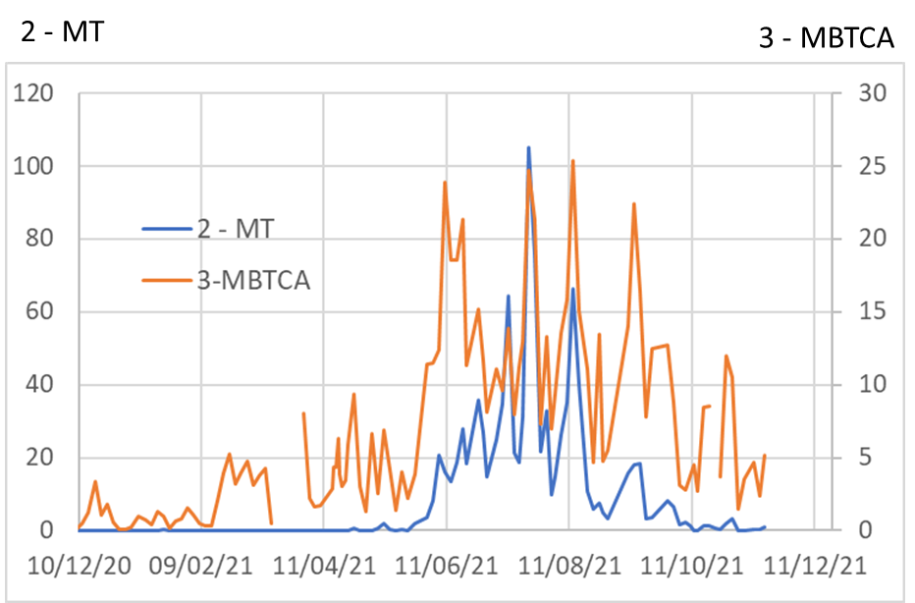


PMF
Chemical profile of sources
Time series of concentrations of tracers
Number of sources
Contribution of sources
Proportion of sources

Slide 14
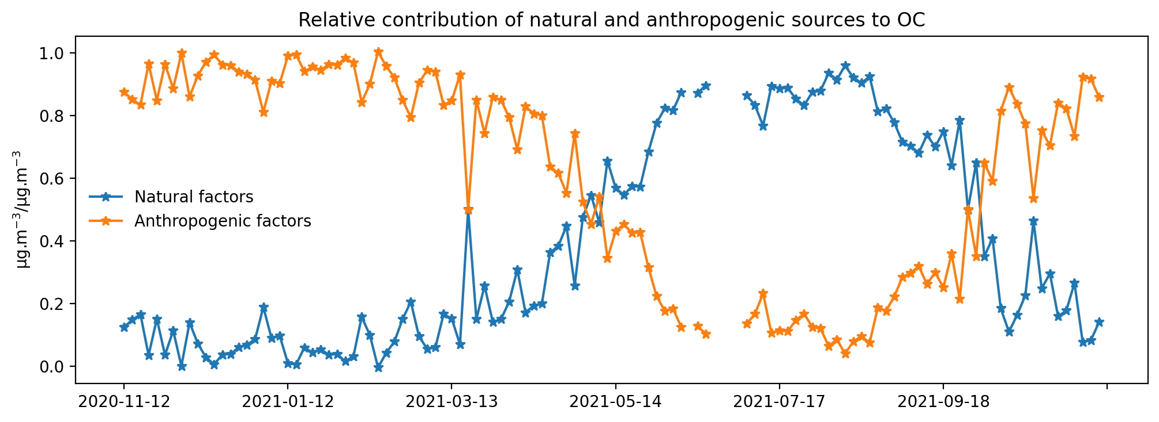
PMF
Chemical profile of sources
Time series of concentrations of tracers
Number of sources
Contribution of sources
Proportion of sources
PMF study in Kanal (Slovenia)
(rural site in a gentle Alpine Valley)
Project with G Mocnik
PMF with PBOA and BSOA tracers

Slide 15
PMF
Chemical profile of sources
Time series of concentrations of tracers
Number of sources
Contribution of sources
Proportion of sources
The chemical profiles give the ratio of each
tracer / OC
in the source
We can try to apply these ratio to the data from the EMEP campaign to make an estimation of the biogenic fraction of OC

Slide 16
Thank you for your attention
Acknowledgements
Funding from EMEP for the analyses
Sophie Darfeuil and Dielleza Tusha for setting up the LC-MSMS run
Patrick Ginot for setting up the IC-MS run
Vy Ngnoc and Dielleza for the animated
Many people on the Air O Sol analytical facility at IGE for the analysis of samples
Many people in French AASQA’s and several University labs for collecting samples in France
Many other people across all Europe for collecting the other samples

